Slide 1

Optimizations and the Future
Justin Pihony
@JustinPihony | justin-pihony.blogspot.com
Notes:
NEXT: Agenda

Slide 2
Agenda
Basics of Spark
Core API
Cluster Managers
Spark Maintenance
Libraries
SQL
Streaming
MLlib/GraphX
Troubleshooting / Optimization
Future of Spark
Notes:
NEXT:Trouble & Future

Slide 3
Agenda
Basics of Spark
Core API
Cluster Managers
Spark Maintenance
Libraries
SQL
Streaming
MLlib/GraphX
Troubleshooting / Optimization
Future of Spark
Troubleshooting / Optimization
Closures
Broadcast
Partitioning
Future of Spark
Troubleshooting / Optimization
Future of Spark
Notes:
More on Troubleshooting/Optimizations
Closures
Broadcasting
Partitioning
NEXT:Closures

Slide 4
Closures
Notes:
NEXT: Broadcast

Slide 5
Broadcasting
val indexer = Map(…)
val indexer = Map(…)//1MB
rdd.flatMap(rddVal => indexer.get(rddVal))
4 MB
Driver
Worker
Worker
Worker
1 MB
3 MB
indexer
indexer
indexer
indexer
indexer
indexer
indexer
indexer
indexer
indexer
indexer
4 MB
Notes:
(Even closures can cause problems)
Expose problem creating map
Used to transform rdd values; NOTE: close over map…means distributed
What if map takes up 1 MB?
Let’s visualize! Have driver w/ 3 workers
Driver creates 1MB map
Then action called and RDD begins
EACH time worker executes, gets new copy
1MB becomes 4 across network
Happens in parallel for EACH
Results 1MB = MUCH larger…11MB for SMALL, SIMPLE example….think in millions
NEXT: Broadcast helps

Slide 6
Broadcasting
val indexer = sc.broadcast(Map(…))
val indexer = sc.broadcast(Map(…))//Map=1MB;indexer<1MB
rdd.flatMap(rddVal => indexer.value.get(rddVal))
1 MB
Driver
Worker
Worker
Worker
indexer
1 MB
1 MB
indexer
indexer
indexer
indexer
1 MB
indexer
Notes:
Wrap map in call to sc’s broadcast
Pass THAT into closure, accessing via value property
Still trapping, but MUCH smaller..only used to retrieve on worker
Behind scenes?
Driver still creates 1MB and wraps
Instead of across wire for EACH execution, only goes over wire once for each worker. (Workers cache on retrieval)
Now footprint = size times # of workers
(Even that improved, driver bottlenecks)
(Enough overhead that communication cost could offset benefits as machines scaled) NEXT: Starting 1.1

Slide 7
Broadcasting
val indexer = sc.broadcast(Map(…))
val indexer = sc.broadcast(Map(…))//Map=1MB;indexer<1MB
rdd.flatMap(rddVal => indexer.value.get(rddVal))
Driver
Worker
Worker
Worker
indexer
indexer
1 MB
indexer
indexer
indexer
indexer
indexer
Notes:
(changed to bit-torrent…overhead constant while scale)
Once one worker receives
Starts to help send around; significant distribution time reduction
(As of 1.1, wraps up every stage’s function…duh moment)
(Only needed if used in multiple stages or want cache deserialized)
(NOTE: write only driver, readonly worker)
(Should use immutable to signal to future devs)
NEXT:Partitioning pitfalls

Slide 8
Partitioning Pitfalls
Notes:
NEXT: Future of Spark

Slide 9


zero-management cloud platform
Future of Spark
- Databricks FAQ
Notes:
Databricks; corp backing OSS good for wide adoption
Databricks cloud now just Databricks; easier provisioning of cluster overhead/hassle
Defined as 0 mgmt cloud platform
(Basically, prep cluster 1 click;web shell; share; 3rd party apps:BI and visualizations)
NEXT: Spark future itself

Slide 10


Future of Spark
Project Tungsten
Notes:
SparkR, lots to watch there
Tachyon, offheap in memory storage, backed by persistent storage
Project Tungsten, efficiency of mem and CPU
NEXT: Spark Packages

Slide 11

Packages
spark-jobserver
zeppelin
Data Sources
Streaming
Machine Learning
…
Notes:
Spark on server (Ooyala)
Shell in browser
Datasources to integrate more: avro, csv, redshift, etc
Streaming add-ons; esp diff receiver hooks
Machine learning utilities
NEXT: IBM and growth

Slide 12
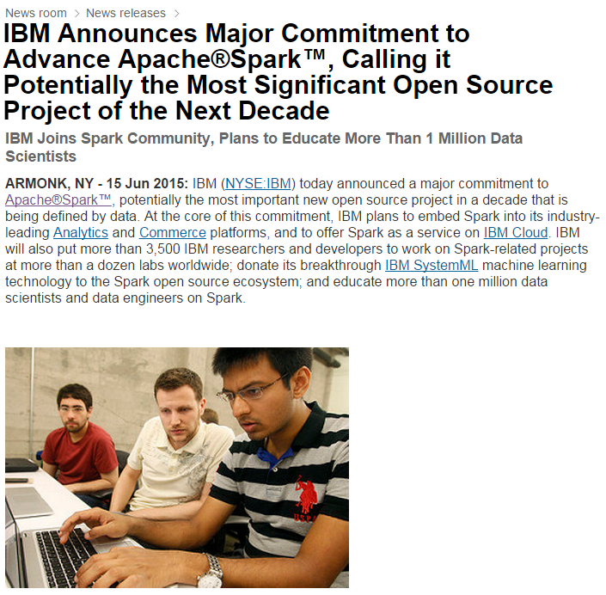
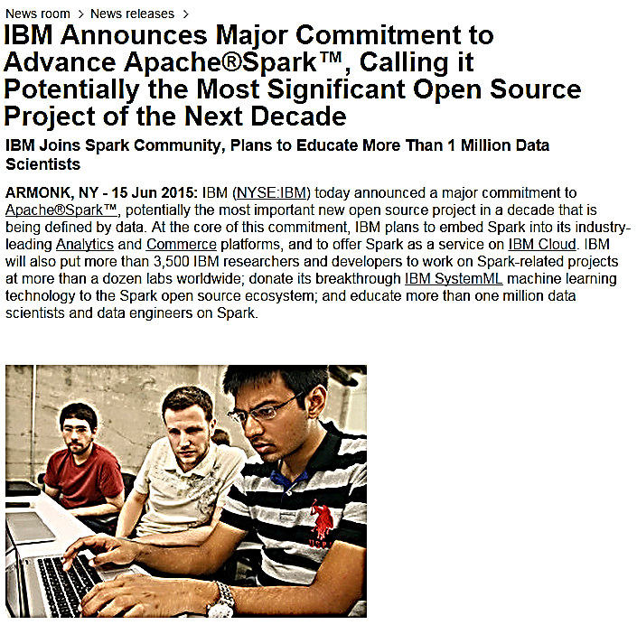
https://www-03.ibm.com/press/us/en/pressrelease/47107.wss
Notes:
“potentially…”, even more influx into Spark
“more than…”, lots of growth
NEXT: Resources

Slide 13
Resources
Patrick Wendell – Spark Performance (2013)
https://www.youtube.com/watch?v=NXp3oJHNM7E
Project Tungsten
http://bit.ly/1KPpFBC
DataStax – Common Spark Troubleshooting
http://bit.ly/1k3iv4K
https://issues.apache.org/jira/browse/spark/
Labels = starter
Notes:
Wendell on Spark Perf
Project Tungsten in more depth
DataStax additional issues
Contribute back
Use starter label to jump in
NEXT: Summary

Slide 14
Summary
Beyond the basics
What’s next?
Notes:
NEXT: Questions?

Slide 15
Final Questions
https://www.surveymonkey.com/r/B27PKZZ
Justin Pihony
@JustinPihony | justin-pihony.blogspot.com
Notes:
NEXT: Agenda

